Slide 1
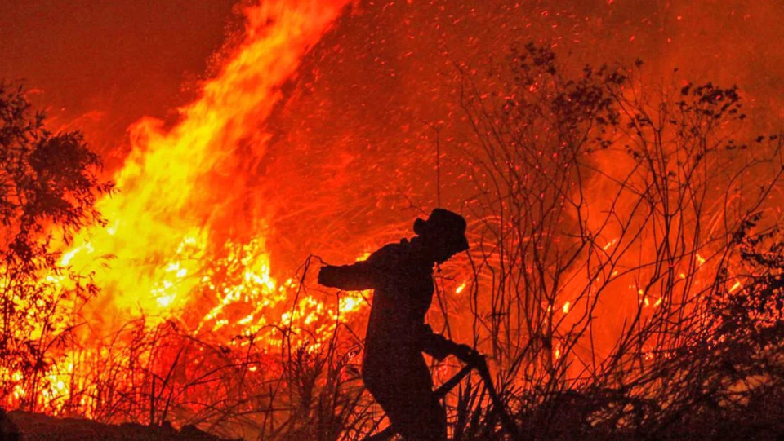
PREDICTING HOTSPOT INTENSITIES
Group ID: 3
Say Yueyang, Symus | He Zeqing | Kwek Yan Qing

Slide 2
TABLE OF CONTENTS
1
INTRODUCTION
2
MOTIVATION
3
PROPOSED SOLUTION
4
ANALYSIS
5
CONCLUSION

Slide 3
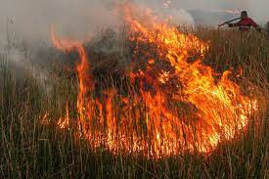
INTRODUCTION
Indonesia’s Forest Fires
Notes:
Haze is one major form of air pollution that Singaporeans face annually. The presence of haze is attributed to the forest fires in Sumatra, Indonesia. Due to the increase in demand of commercial crops, Indonesian farmers have resorted to shifting agriculture, which includes the large-scale slash-and-burn of forest land to produce fertile planting grounds. The resulting air pollution is then spread across the region by the climatic phenomenon El Nino, enveloping Singapore in a blanket of haze and affecting the overall health of Singaporeans. In 2020, Indonesia fires torched approximately 207,000 hectares of forests from January to September. While the area is smaller compared to previous years, the burning resulted in a US$5.2 billion cost towards the Indonesian economy, and the occurrence of toxic smog over the city.

Slide 4
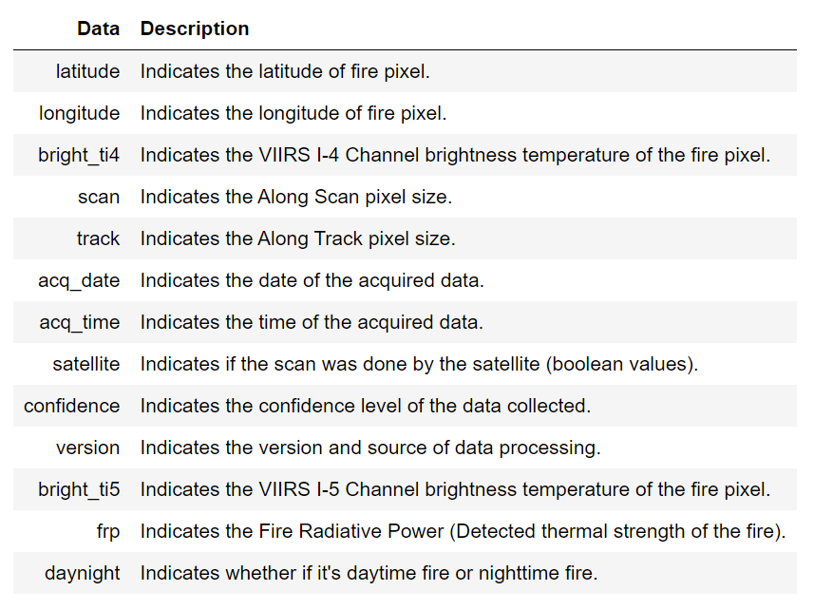
MOTIVATION
Notes:
The objective of our study is to predict the possible intensity of future hotspots in South East Asia, including Indonesia. Hopefully, this study will be able to support further research in estimating the possibility and severity of the occurrences of haze in Singapore.
Our study will be conducted with the relevant data on forest fires in South East Asia. Our dataset is obtained from the National Aeronautics and Space Administration (NASA)'s Fire Information for Resource Management System (FIRMS). It contains both geographical and technical data extracted from the Visible Infrared Imaging Radiometer Suite (VIIRS) sensor aboard their NOAA-20 weather satellite.

Slide 5
PROPOSED SOLUTION
Data Acquisition and Visualization
Pre-processing
Generate Predictive Models
Compare Accuracy of Forecast
To predict Fire Radiative Power (FRP) from location and brightness data.

Slide 6
Data Acquisition
Data from NASA’s Fire Information for Resource Management System (FIRMS).
Visible Infrared Imaging Radiometer Suite (VIIRS) sensor aboard their NOAA-20 weather satellite.
Notes:
Project description
Motivation
Proposed solution
Analysis
Conclusion/future work

Slide 7
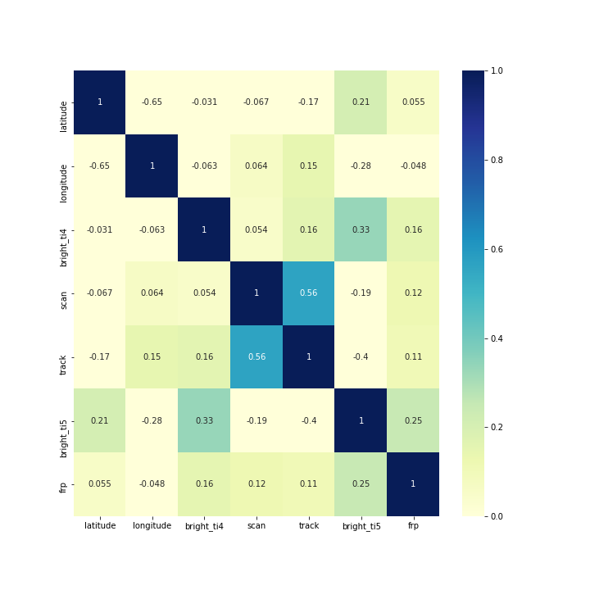
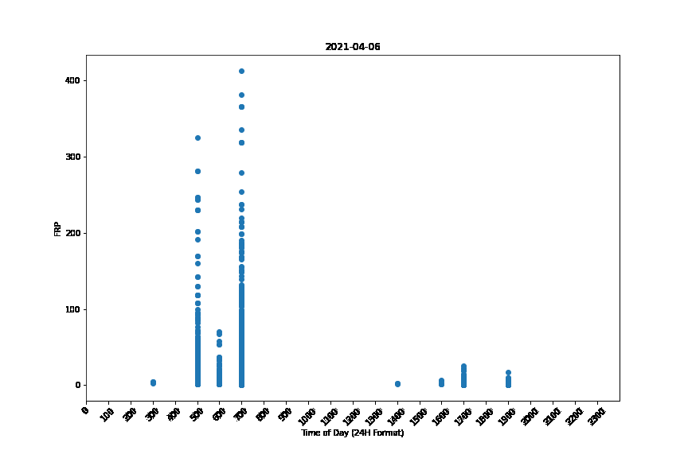
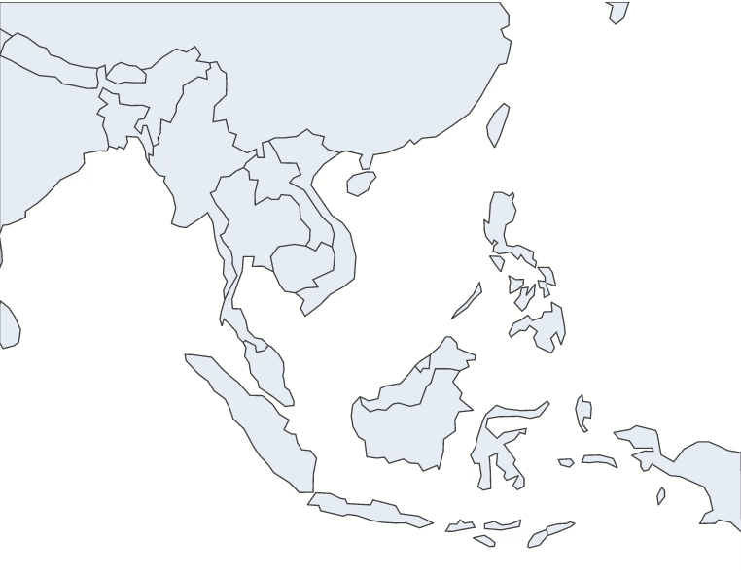
Data Visualization
FRP-Time Relation
Covariance Heatmap
Geographical
Map

Slide 8
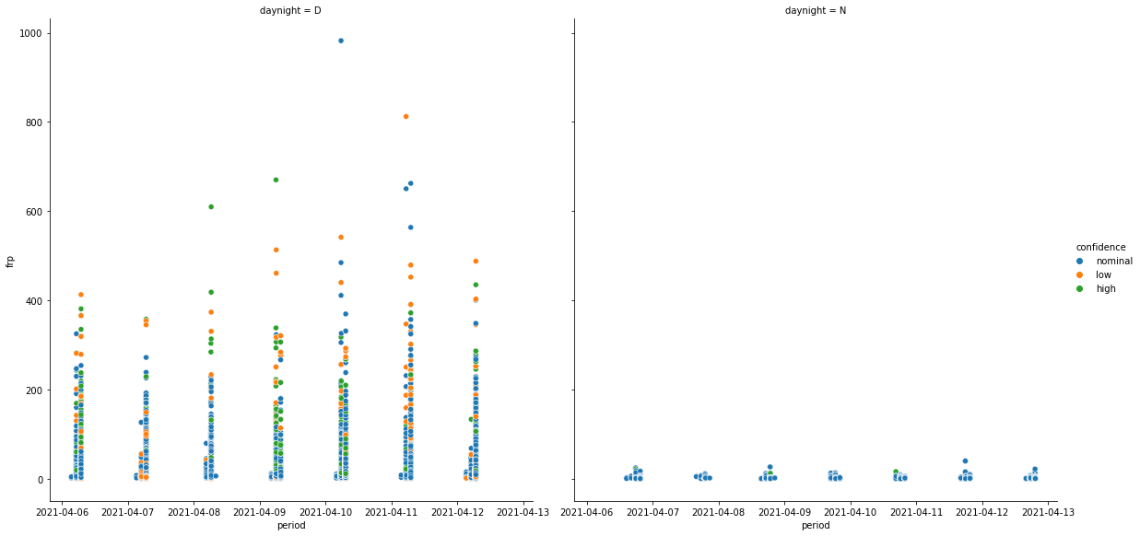
Data Visualization

Slide 9
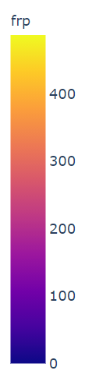
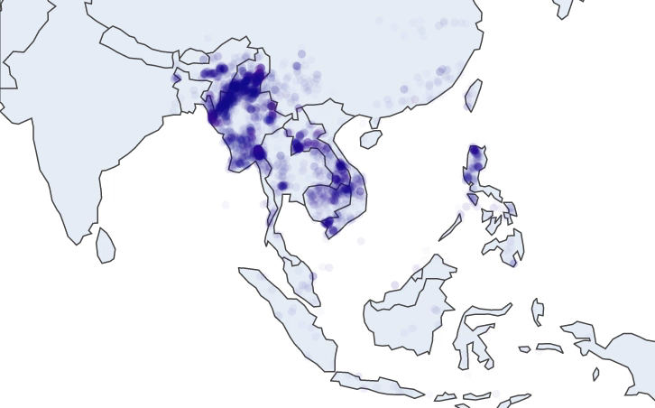
Data Visualization
- Fire Data within the same region is concentrated to a certain location
- Patterns in when the fires are detected within the same 7 day period.

Slide 10
Data Visualization – Correlation Heatmap
Trends Observed:
Correlation between Brightness & Fire Radiative Power
Correlation between Scan and Track (Related to Satellite Movement)

Slide 11
Predictive Model

Slide 12
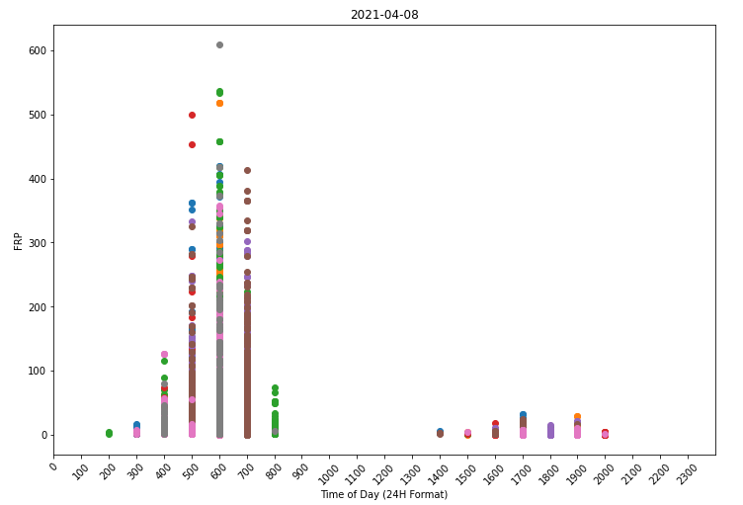
PROPOSED SOLUTION
Exploratory Data Analysis
Data Pre-Processing

Slide 13
PROPOSED SOLUTION

Slide 14
ANALYSIS
OBSERVATIONS
LIMITATIONS
RECOMMENDATIONS

Slide 15
ANALYSIS
OBSERVATIONS
LIMITATIONS
RECOMMENDATIONS

Slide 16
ANALYSIS
OBSERVATIONS
LIMITATIONS
RECOMMENDATIONS

Slide 17
CONCLUSION

Slide 18
CONCLUSION

Slide 19

THANKS!
Do you have any questions? youremail@freepik.com +91 620 421 838
yourcompany.com
Please keep this slide for attribution

Slide 20





Storyset
Create your Story with our illustrated concepts. Choose the style you like the most, edit its colors, pick the background and layers you want to show and bring them to life with the animator panel! It will boost your presentation. Check out How it Works.
Pana
Amico
Bro
Rafiki
Cuate

Slide 21
Use our editable graphic resources...
You can easily resize these resources without losing quality. To change the color, just ungroup the resource and click on the object you want to change. Then, click on the paint bucket and select the color you want. Group the resource again when you’re done. You can also look for more infographics on Slidesgo.

Slide 24
JANUARY
FEBRUARY
MARCH
APRIL
MAY
JUNE
PHASE 1
Task 1
Task 2
PHASE 2
Task 1
Task 2
JANUARY
FEBRUARY
MARCH
APRIL
PHASE 1
Task 1
Task 2

Slide 27
...and our sets of editable icons
You can resize these icons without losing quality.
You can change the stroke and fill color; just select the icon and click on the paint bucket/pen.
In Google Slides, you can also use Flaticon’s extension, allowing you to customize and add even more icons.

Slide 28
Educational Icons
Medical Icons

Slide 29
Business Icons
Teamwork Icons

Slide 30
Help & Support Icons
Avatar Icons

Slide 31
Creative Process Icons
Performing Arts Icons

Slide 32
Nature Icons

Slide 33
SEO & Marketing Icons

Slide 34


